Slide 1
UPI Payments Analytics & Risk Insights Presented By
Saurav Raj
Data Analytics Course #801
By Career247

Slide 2
Business Context & Core Challenges
UPI operate at massive scale and face multiple operational and strategic challenges.
Core Challenges:
Fraud Risk Account takeovers, SIM Swap fraud, Phishing, device spoofing
Transaction failures
Bank downtime, Network latency, API errors
Device & Security risk
Rooted devices, suspicious patterns
Customer Transaction Support
Reducing Resolution time, Showing timely alerts for suspicious transactions

Slide 3
Project Objective
To analyse operational, transactional and risk data from UPI Systems. Identifying patterns of customer and merchant behaviour, payment trends, and fraud risk.
Develop KPIs and visuals for executive and operational decision making.
Deriving strategic data-driven insights and actionable business recommendations to improve platform performance and user trust.

Slide 4
Core Analytical Goals
The goal is to use data analytics to improve platform reliability, security and growth.
Reduce transaction failure rates
Detect and prevent fraud in real time and reduce resolution time.
Improve customer retention and engagement.
Increase merchant activity and improve transaction frequency.
Identify high risk devices and behaviours.
Enable data-driven strategic insights for better decision making for platform operations.

Slide 5
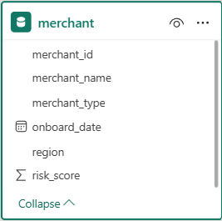
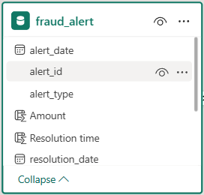
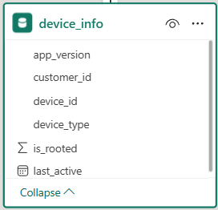
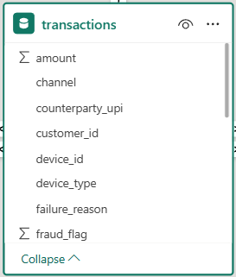
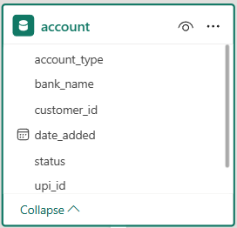
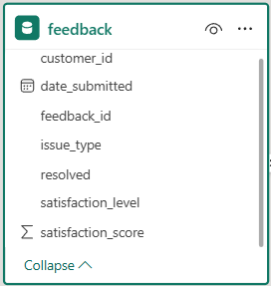
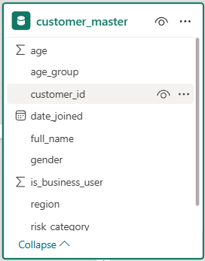
Analytical approach
DataSources

Slide 6
Work Flow
Clean & validate data in excel
Design Database and create tables in SQL.
Load data and drew ER diagram.
Established data pipeline from SQL to Python for analysis.
Data transformations and EDA in python.
Statistical Analysis in Python
Executive and Operations/Fraud Analysis Dashboard in Power BI.
Derive Strategic Data-driven insights and recommendations.

Slide 7
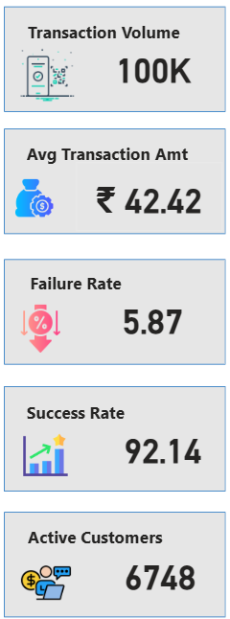
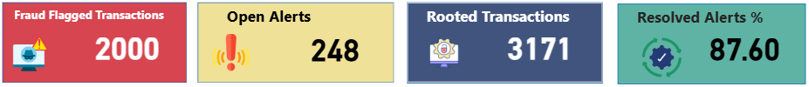
Core KPIs

Slide 8
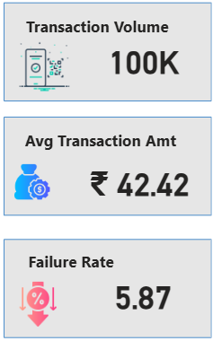
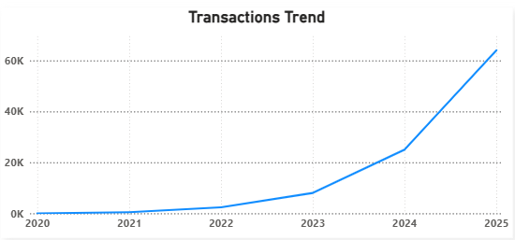
Insight #1 : Growth in UPI transactions
Volume of transactions grew from ~0 to 60k+ (2025).
Sharp spike after 2023 especially since 2024.
Growth is Strong but fraud exposure.
Recommendation: A Strong fraud detection will impact the Transactions in positive way.
Estimated Impact:
As fraud rate is ~ 5.87 , failure transactions = 5.87 *100k = 5870
Even ~1% improvement will lead to 1000 more successful transactions.
And ~ Rs. 42 * 1000 = Rs. 42000 + Recovery potential.

Slide 9
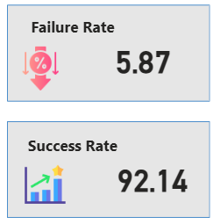
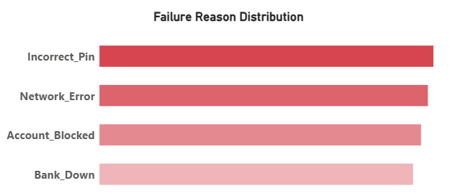
Insight #2 : Failures cannot be ignored despite high success rate.
We observed that failure rate is ~5.87% and high success rate ~92% still we cannot ignore the failure of transactions.
We also find that the major reasons of failure of transactions are incorrect pin and network error.
Recommendation: By improving UX of UPI app and giving hints to retry PIN can reduce the incorrect pin failure reason and also by optimizing network will alleviate the network error issues.
Estimated Impact: Even ~2% of improvement will lead to 2000 recovered transactions and hence it will impact revenue by ~ Rs. 80-100K.

Slide 10

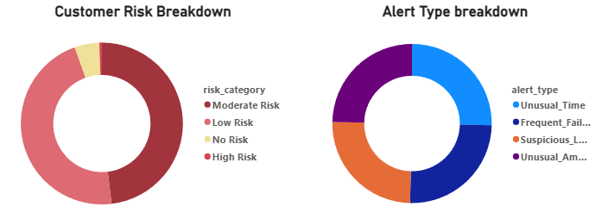
Insight #3 : Fraud risk is pattern driven and it can be proactively mitigated
Fraudulent activity is not random its pattern driven concentrated around unusual_time, unusual_amt, frequent_failure and suspicious_login with 2000 flagged fraud transactions.
Significant portion of users fall under low to moderate risk.
And it can be proactively mitigated rather than react after occurrence.
Recommendation: Introduce real time transaction blocking for high risk patterns, apply stricter authentication for suspicious activities.
Estimated impact: If 20% of fraudulent transactions prevented (~400 transactions) , it can save directly ~ Rs. 16000.
Additional benefit includes reduce financial loss,
improved compliance.

Slide 11
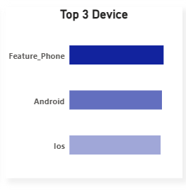
Insight #4 : Device based user behaviour
We observed that Feature_phone, android, IOS is widely used for UPI transactions, but Feature_phone is comparatively top in device, it suggests that UPI still heavily used in low-end device segment
Recommendation: Optimize lightweight apps, Simplify UI for low-bandwidth users.
Estimated Impact: If adoption improves by 10% in this segment could add ~5-10k transactions. And could increase revenue by Rs. 42 * 5000 = ~2.1 Lakh.

Slide 12
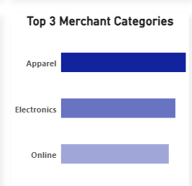
Insight #4 : Merchant Categories driving volume
Top Categories that include Apparel, Electronics, Online.
Spending concentrated in few high value categories.
Recommendation: Partner with these merchants, offer cashback/ targeted promotions.
Estimated Impact: Even ~5% significant increase in these categories can significant volume boost.

